Slide 1
R O I
by don vellathottam

Slide 2
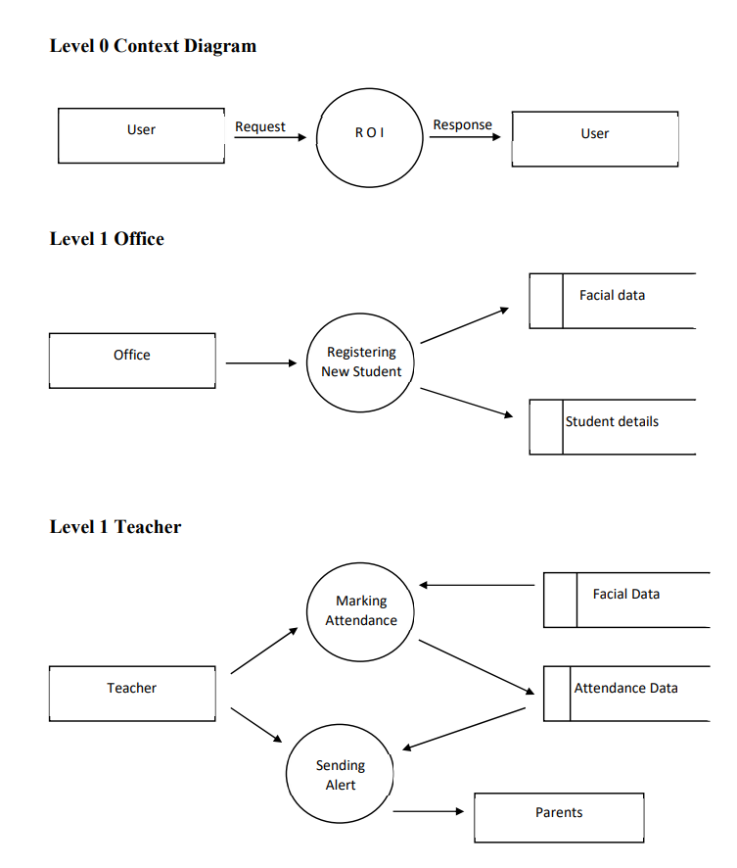

Slide 3
